Slide 1



MRC River Monitoring Technology Competition
Topic: Water Quality Monitoring System
Virbora NY, Phanna TEOM, Socheata LEAVCHUM, Sokheang EANG
National Polytechnic Institute of Cambodia
Phnom Penh, Cambodia

Slide 2
Table of Contents
Introduction
Methodology
Design and Implementation
3.1. Hardware Design
3.2. Software Design
Experimentation
Conclusion
Reference

Slide 3
1. Introduction
Water Quality Monitoring System could collect and send real-time telemetry data from any water source. Using different types of sensors, the system can monitor the following data, such as:
TDS (Total Dissolved Solids)
PH (Potential of Hydrogen)
Dissolved Oxygen
Water Temperature

Slide 4
2. Methodology
Design and Innovation
Self-designed and Self-fabricated PCB
Real-time Monitoring Software (IoT Wireless)
Solar Tracking
WiFi Support
Future Prediction Using AI
Automatic Data Backup

Slide 5
2. Methodology
Special Features
Up to 60m Measurement from Station
Realtime Measurement
Feedback the Solar Position
UI Monitoring
Low Power Consumption
Waterproof

Slide 6
2. Methodology
2.1 System Block Diagram

Slide 7
3. Design and Implementation
3.1. Hardware Design

Slide 8
3.1. Hardware Design
Main System Hardware
3.1.1 Power Management Board
Notes:
1. Power Management Board

Slide 9
3.1. Hardware Design
3.1.2 Solar Tracker

Slide 10
3.1. Hardware Design

Slide 11
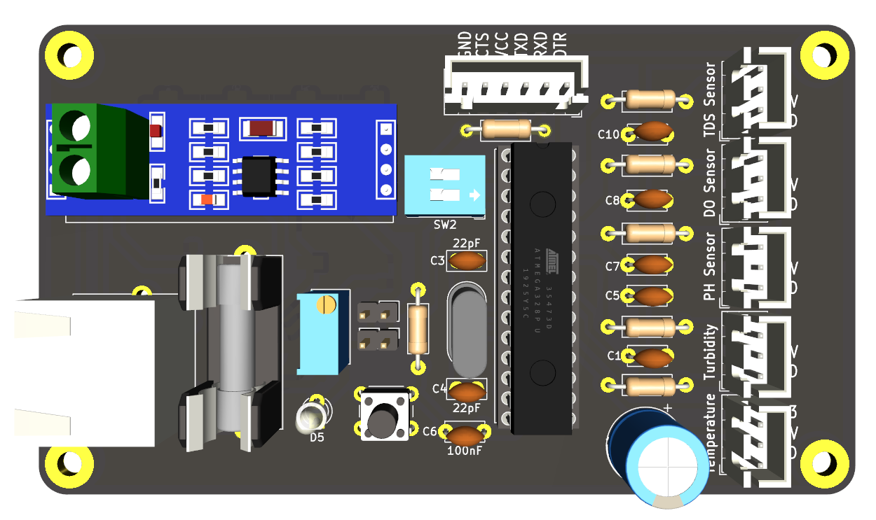
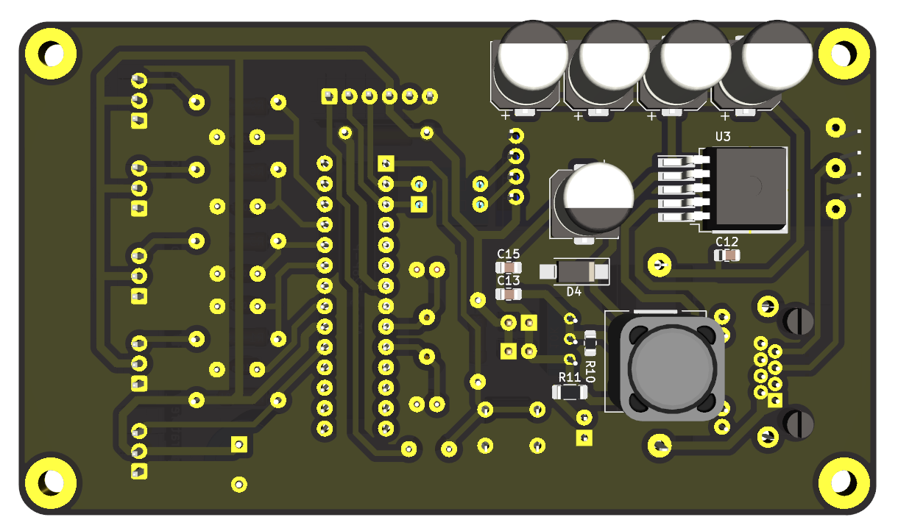
3.1. Hardware Design
Sub System Hardware
Notes:
1. Power Management Board

Slide 12
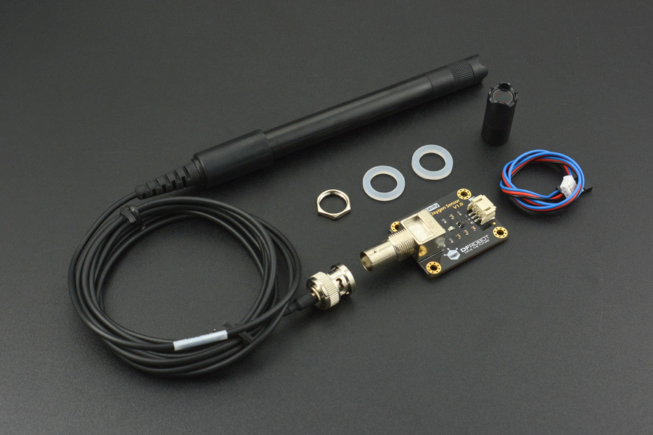
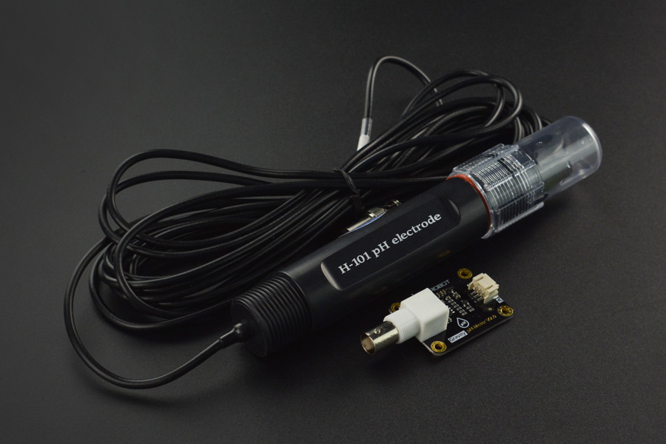
3.1. Hardware Design
Sensor Choice
Notes:
1. Power Management Board

Slide 13
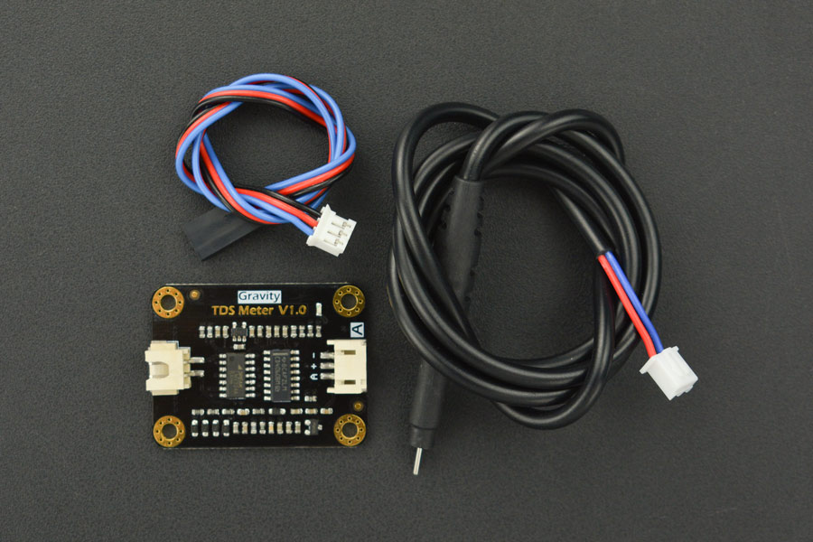
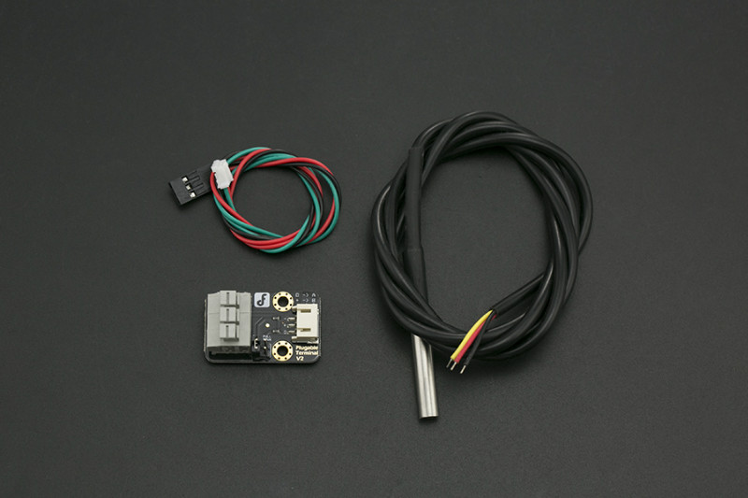
3.1. Hardware Design
Sensor Choice
Notes:
1. Power Management Board

Slide 14
3. Design and Implementation
3.2. Software Design
3.3 Software Architecture Diagram

Slide 15
3.2. Software Design
3.3 UI Monitoring Design

Slide 16
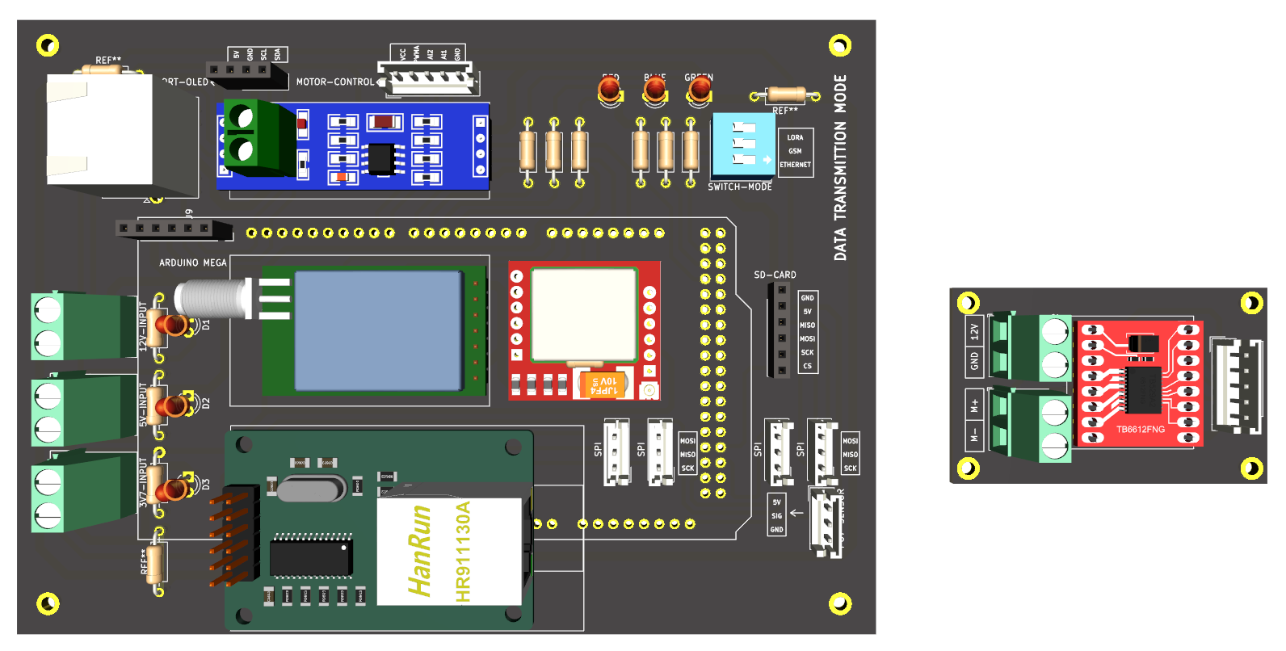
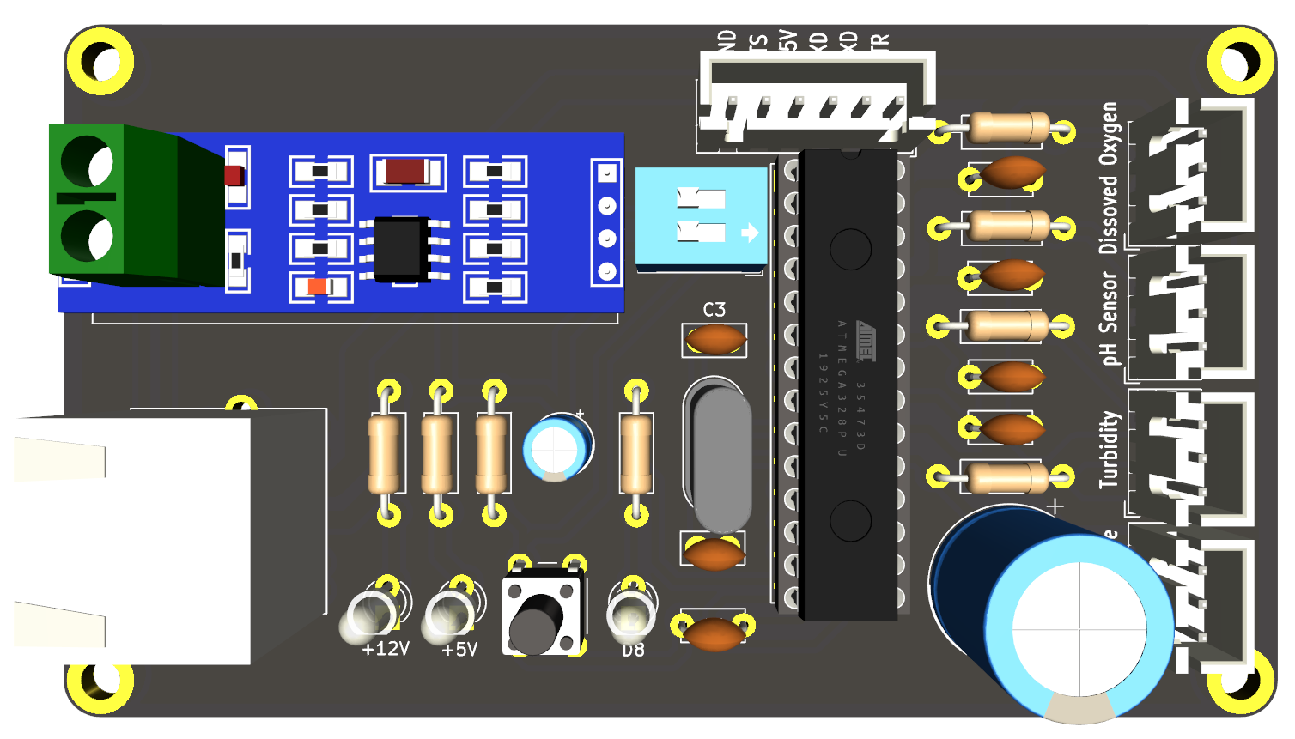
3. Experimentation
Hardware Design
(a) Main System Hardware
(b) Sub System Hardware
3.1 PCB Hardware Design

Slide 17
5. Conclusion

Slide 18
Reference
[1]. MRC. (2018). 2016 Lower Mekong Regional Water Quality Monitoring Report . Vientiane: MRC Secretariat.
https://doi.org/10.52107/mrc.ajg6r1
[2]. World Health Organization. (‎2017)‎. Water quality and health - review of turbidity: information for regulators and
water suppliers. World Health Organization. https://apps.who.int/iris/handle/10665/254631. License: CC BY-
NC-SA 3.0 IGO
[3]. “Dissolved oxygen (DO) | A monitor's Guide to Water Quality.” [Online]. Available:
https://datastream.org/en/guide/dissolved-oxygen. [Accessed: 28-Jan-2023].
[4]. “Data Portal,” MRC. [Online]. Available: https://portal.mrcmekong.org/time-series/dissolved-oxygen.
[Accessed: 28-Jan-2023].
[5]. MRC. (2021). Situation Report on Dry Season Hydrological Conditions in the Lower Mekong River Basin:
November 2020–May 2021. Vientiane: MRC Secretariat. https://doi.org/10.52107/mrc.qx5yo1
[6]. MRC. (2022). Mekong Low Flow and Drought Conditions in 2019–2021. Vientiane: MRCnSecretariat.
https://doi.org/10.52107/mrc.qx5yo7
[7]. MRC. (2021). Technical Guidelines on the Implementation of the Procedures for Water Quality . Vientiane: MRC
Secretariat. https://doi.org/10.52107/mrc.ay2l12

Slide 19
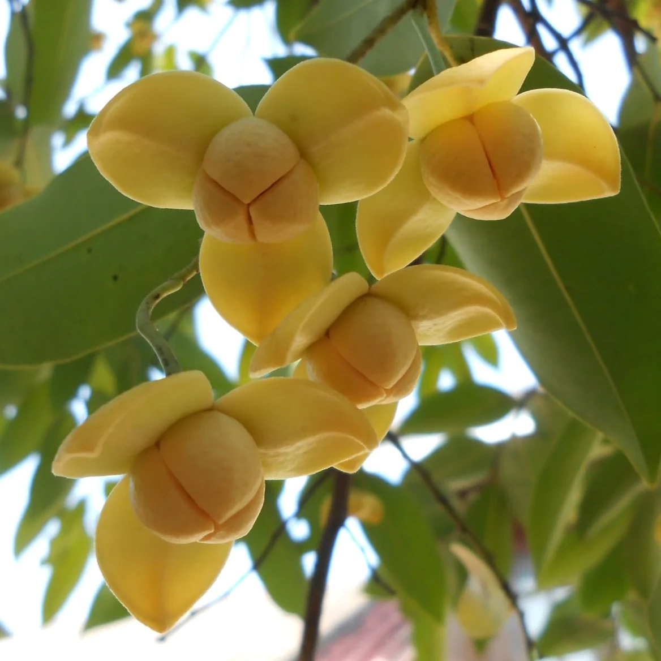


សូមអរគុណ
Thank You
Faculty of Electronics
National Polytechnic Institute of Cambodia

